Slide 1
-Delver-
A lonely trip through an ever-changing labyrinth.
-Evan McConnell

Slide 2


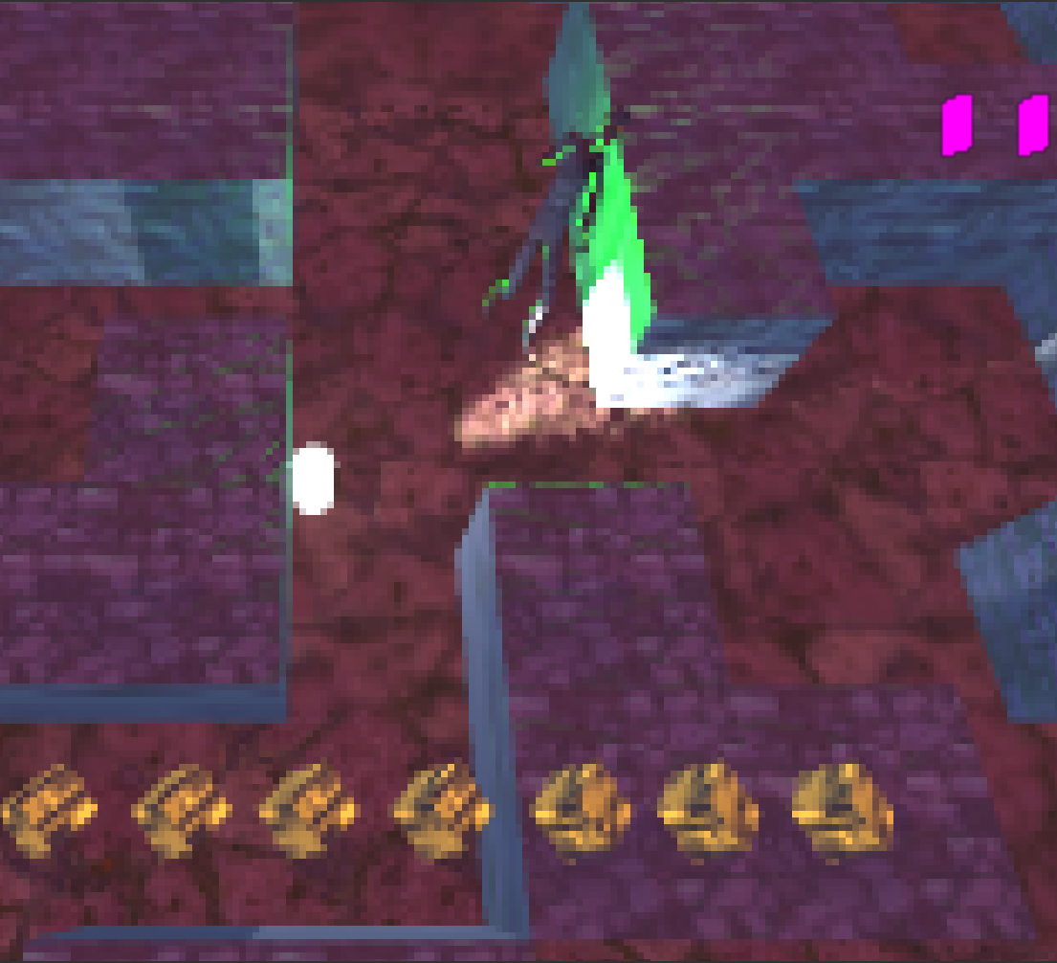
Overview
The objective of the game is to collect all the items in the level before time runs out, while avoiding the patrolling enemies.
As the player progresses the level will change and the player must find their way through each new maze. As the players lives do not replenish it is a race to see how high a player can score before losing.

Slide 3
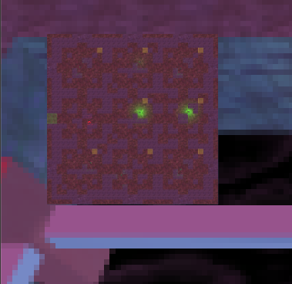
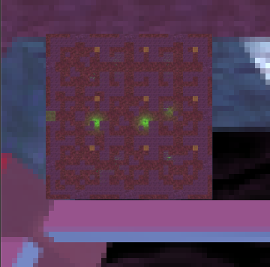
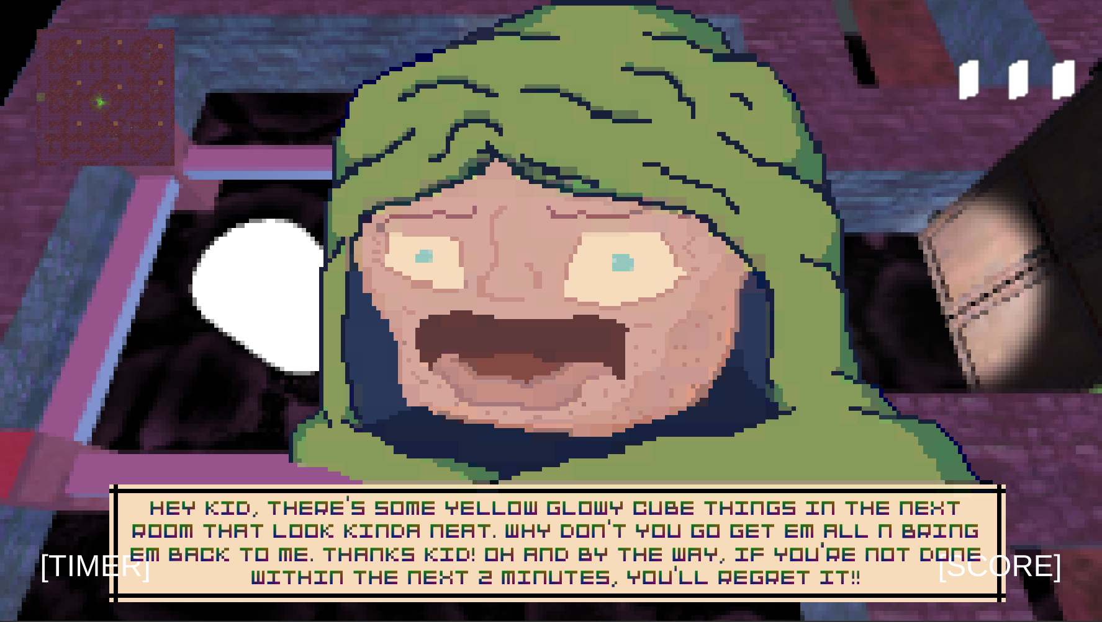
Key Mechanics
The levels themselves act as a mechanic as they are ever changing. Each time the player completes a level, it reshapes itself creating a new obstacle.
Interactable NPCs add a sense of intractability to the world. Depending on the circumstances, the NPC will have a different response to the player.

Slide 4
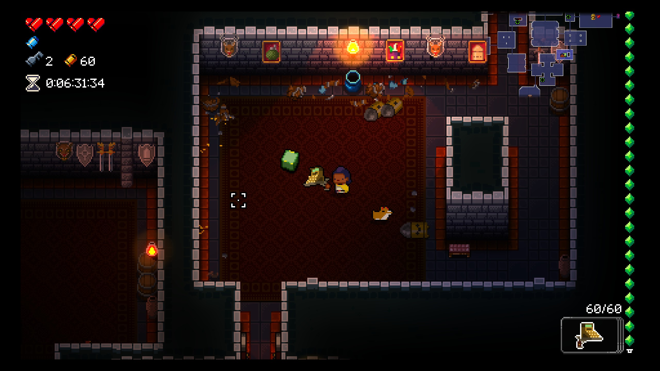
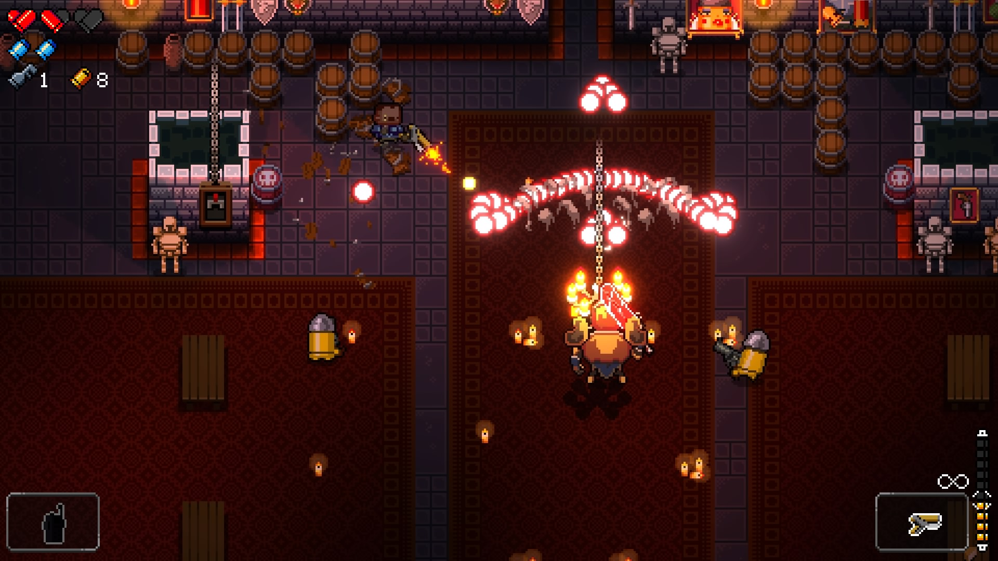
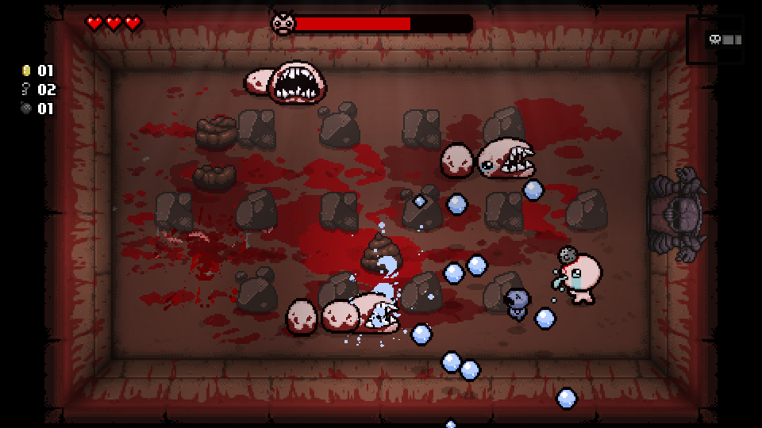
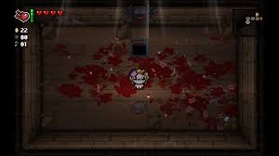
Similar Titles
Enter The Gungeon
The Binding of Isaac
Randomly generated levels.
Bullet hell combat.
Collectable items
Interactable NPCs.
Randomly generated levels.
Collectable items.
Shoot-em-up combat.

Slide 5
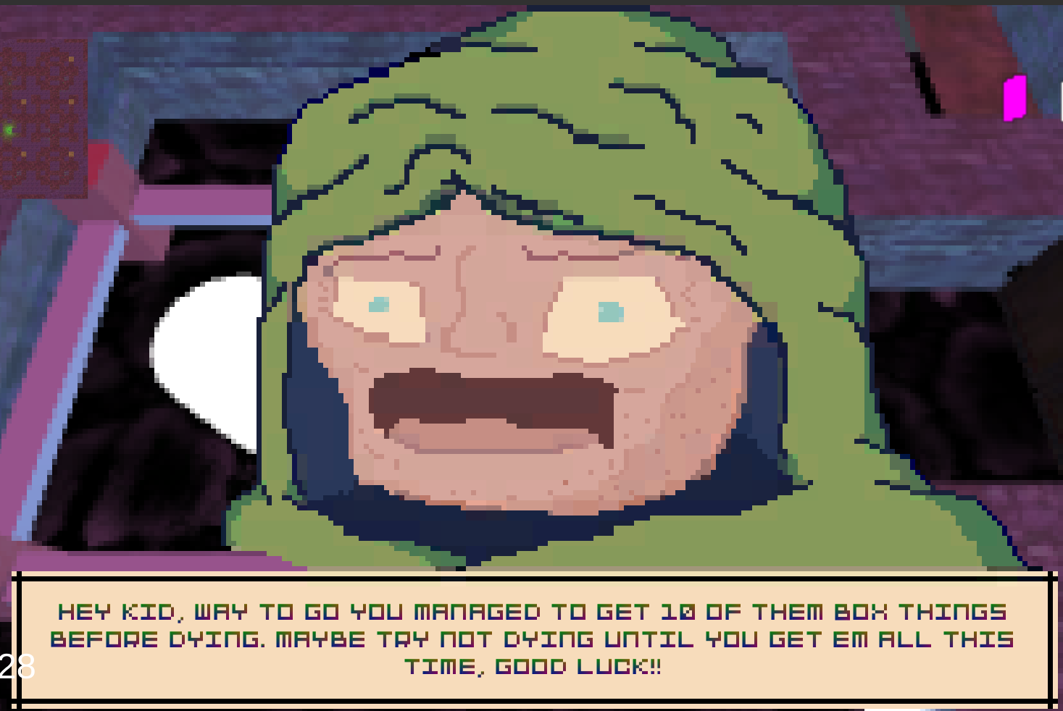

Difficulties
Level Generation
NPC
Instantiating shops with correct orientation.
Baking navmesh.
Instantiating sequential levels.
Animating sprite on a canvas.
Attaching 2D sprites to the player.

